Slide 1
Augmented Reality Innovations
Changing the learning environment for the deaf.
Lehi Alcantara
Michael Hughes
Kellie Kercher
Ian McGuire
Owen Riley
Meagan Steele

Slide 2
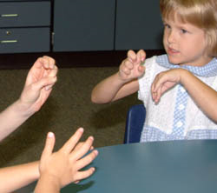
Project Overview
To improve the learning environment for the deaf:
Develop a prototype that projects an ASL interpreters on a HUD
Build a server to communicate video to the displays
Create a user interface for testing
Projected three year BYU Planetarium deployment plan

Slide 3
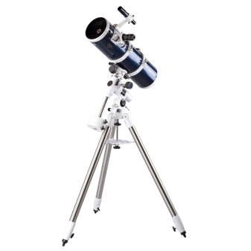
Our Scope
Development environment
Obtain AR set
Setup a dedicated server
Create an API for real-time tracking of controls
Create a working prototype
Build a usability testing environment

Slide 4
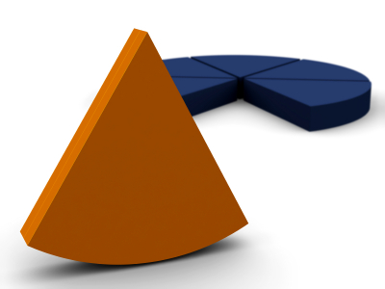
Beyond Our Scope
The Final Implementation
Integration with Planetarium System
Provide Live ASL Interpretation
In-depth User Testing

Slide 5
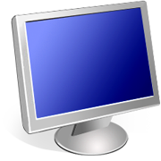

Development and Testing
AR Glasses with ASL for User
Video for Testing
DirectX
Package
Development Environment:
Visual Studio
DirectX
UI for controlling ASL Video via Mouse
Server
Size
Distance
Transparency

Slide 6


Testing Environment
Size
Distance
Transparency

Slide 7
Deliverables?
Demonstrable working prototype:
Video successfully streams between server and glasses
The API solution correctly and quickly modifies streaming video displayed on the glasses
Working usability test environment
Sample test cases
Technical and User Documentation
Logging?
Notes:
We are delivering:
UI
Video Control
Logging Script
Headset Suggestions

Slide 8
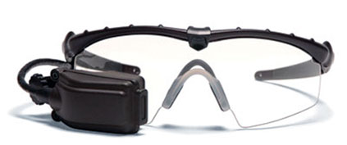
Chosen AR Display: Vuzix Tac-Eye LT
Child suitable
Durable
Lightweight
Attaches to prescription and non-prescription lenses
Within Budget - $3,500

Slide 9
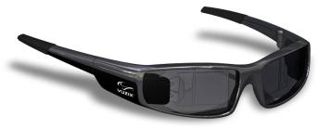
Choosen AR Display: Vuzix
Tac-Eye LT
Binocular Glasses
Child Suitable
Durable
Lightweight
Attaches to prescription and non-prescription glasses
High-contrast Display
‘ordinary-looking sunglasses’
Early summer

Slide 10
UI and Video Manipulation?
Many Control Variables for the Interpreter Video
Brightness
Location
Size
Transparency
Develop default settings for the Planetarium
API to be used for further software development
Open Framework

Slide 11
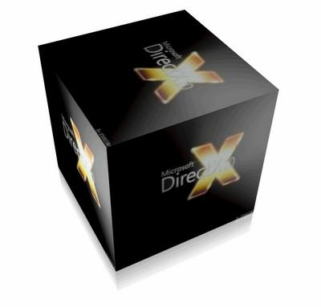
MFPlayer?
DirectX/Microsoft Media Foundation selected
Proven reliability and support
Developed and maintained by Microsoft
Capabilities for simple video transformations
Easy implementation on Windows Platform

Slide 12
The Logging Script?
Logging every settings modifications users make in testing phase.
Save it to a file.
Subject naming convention.
CSV format.

Slide 13
MFPlayer Demo

Slide 14
Results?
Logging
Parent Program to start 2 MFPlayers
User Controls

Slide 15
User Reactions to Prototype
Focus Group

Slide 16
Schedule (From Gantt Chart)
Accomplished
Research Heads Up Displays – Oct 9th
Order Headsets – Oct 24th
Obtain Server - Nov 4th
Prepare UI Video – Nov 11th
Obtained ASL Test Film– Nov 11th
Select Development Platform – Nov 14th
Install test API software – Nov 22nd
Headsets Expected – Dec 5th
Design UI – Jan 9th
Verify Designs with Customer – Jan 13th
Test Compatibility of Glasses with Server – Feb 17th
First Focus Group – Feb 18th
Implement UI Changes – Feb 24th
Finalize UI with customer – March 17th
Code and Implement API image controls – March 22th
Second Focus Group– March 24th
Make adjustments to system – April 5th
Train and create documentation for client – April 11th

Slide 17
Funding and Resources
NSF Funding $14,693 + IAB $240 + Department Funding
Acquired Resources:
$3,500 – Headset Display for Testing
$1,699 – Backup Headset Display
Donated by Customer – Server Laptop
Time and Resources donated by KBYU - filming
Free for Microsoft Users – Microsoft Media Foundation
Free for IT students from MSDNAA – Visual Studio
$120 – Focus Group compensation
Future Expenditure:
$10,000 – interpreters
$2,500 – Project recruiting and compensation

Slide 18
Future Development
3 Year Project
Testing
Lab testing with targeted users
Planetarium testing
Planetarium Use
Implement prototype in planetarium

Slide 19
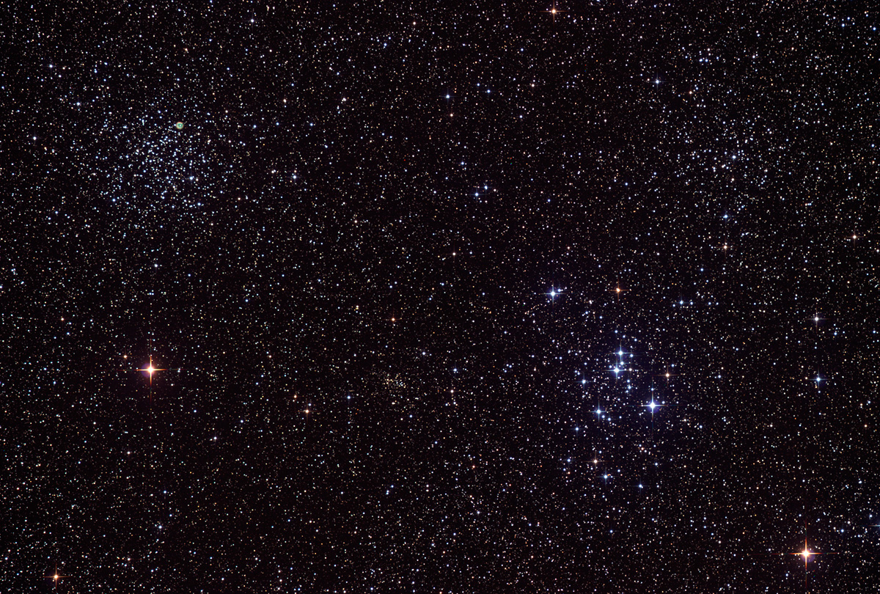

Questions?

